Slide 1
LEOFORFRIENDS
We have the answer to your question

Slide 2
Today’s Agenda
Introduction
Database design
Server side design
Intercom to client and server
Client side design
DEMO

Slide 3
BIG CONCEPT
We are always in need of some efficient platforms to share or to know information about job interviews, tips and solutions to some onerous tasks.

Slide 4
LEOFORFRIENDS
Our web application creates a platform where an user can post his question and get answers. He can also post his version of solution or search for typically best one, there by making ones work plain-sailing.

Slide 5
Database Design
1
How and Why about data .

Slide 6
How the data is stored
In our web application, we need to store users’ information and all the questions/answers they post.
For this reason we designed a database that stores all the data we mentioned before.
We access the database through the JDBC in order to store and retrieve data.

Slide 7
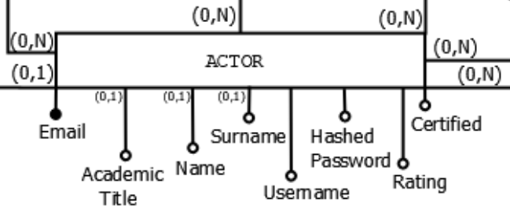
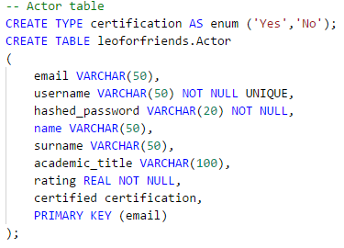
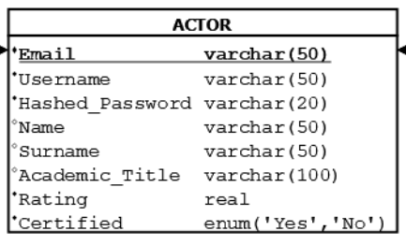
After requirements analysis and functional requirements gathering, we proceeded with:
Design of the database
Conceptual Schema
Physical Schema
Relational Schema

Slide 8
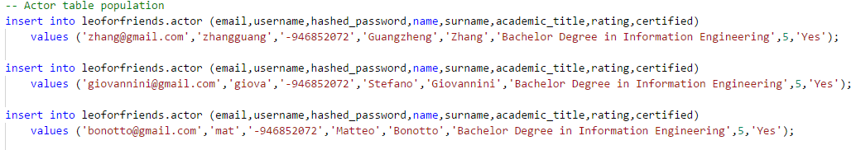
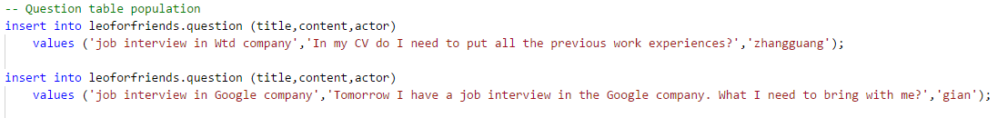
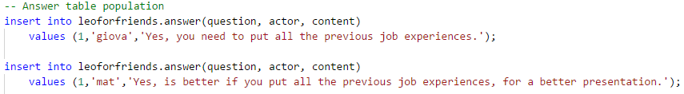
Database Population
For testing the application, we populated the database with:

Slide 9
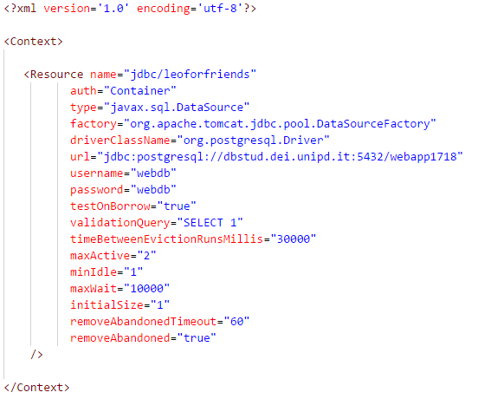
In order to allow our application to access the database designed for it, we need to specify the parameters for the connection as follows:
Access to the database
‘The drive we used’
‘The URL in which we specify the server where the database is stored and the name of the database’
‘Username and password for accessing the database’

Slide 10
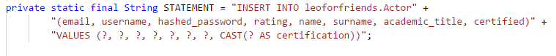
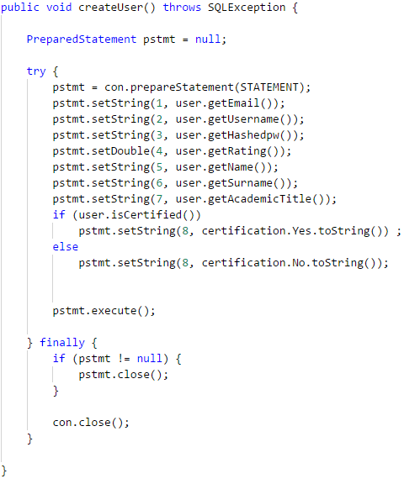
Operation on the database
Finally we implemented java classes in order to:

Slide 11
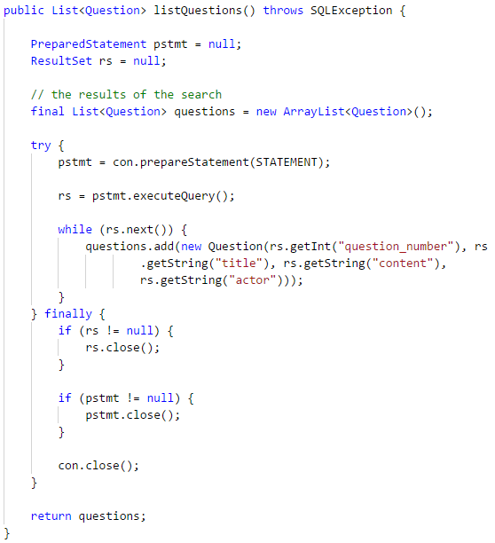
Operation on the database
Finally we implemented java classes in order to:

Slide 12
Server Side Design
2
Servlets, JDBC, JavaBeans, REST.

Slide 13
Server Side Components
Our Web Application was designed to run on a Web Container implementing the JEE API, and it is thus structured in:
Servlets
JavaBeans
It also makes use of JDBC paradigm to access the data stored in the DataBase.
Here follows a description of representative instances of the technologies we used.

Slide 14
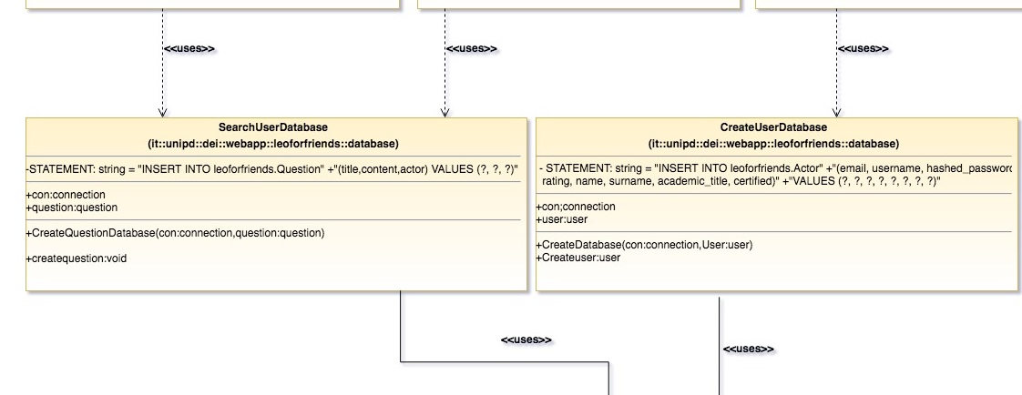
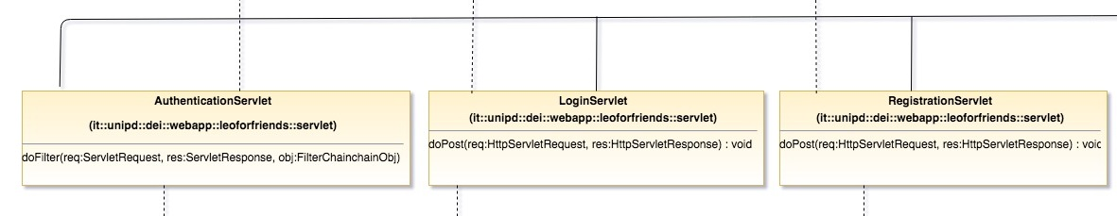
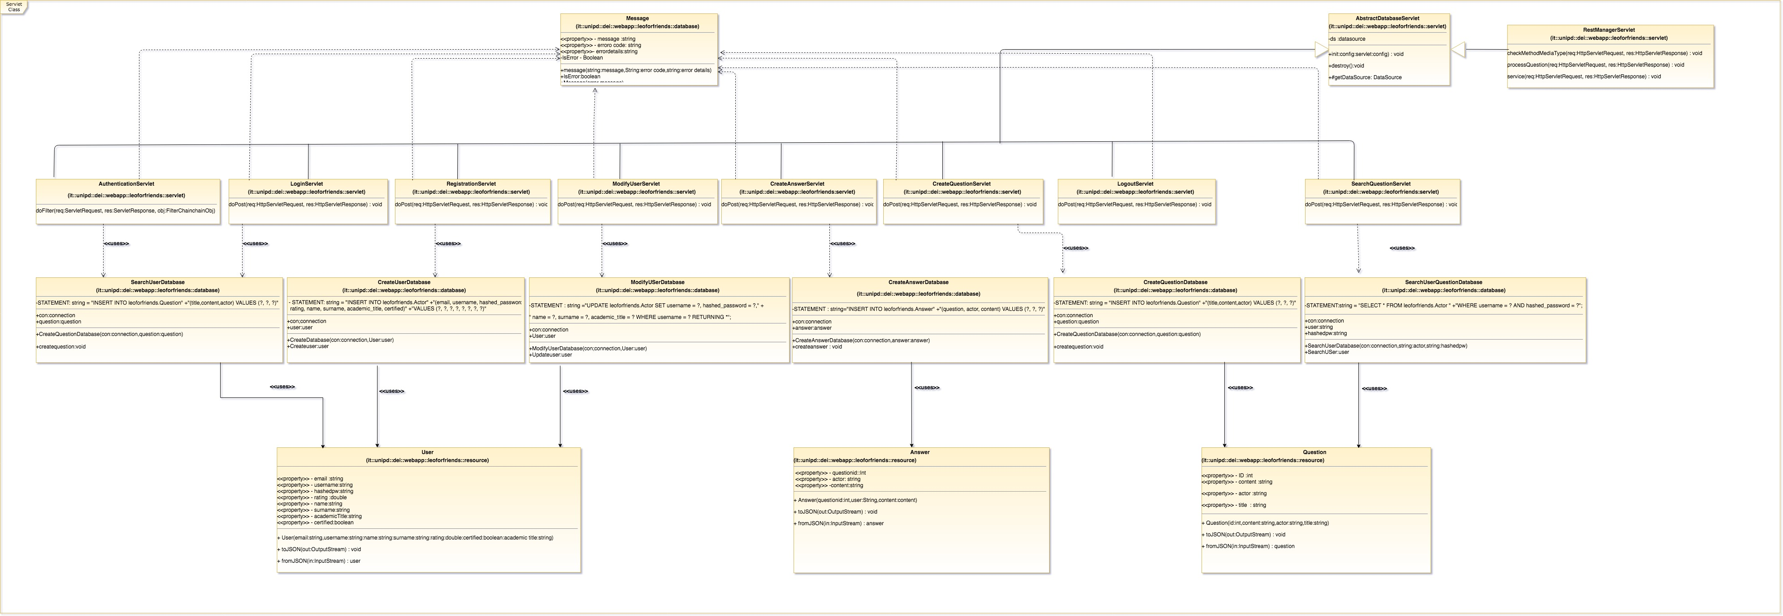
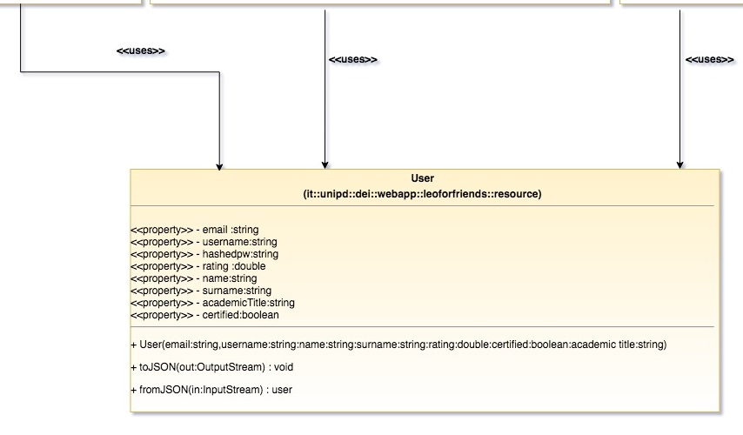
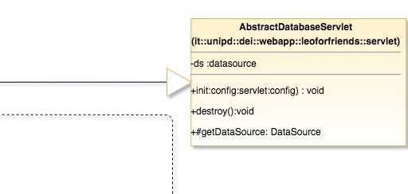
Servlet hierarchy and interactions are reported in the UML class diagram.
Servlets

Slide 15
Server Side Components
Some resources are exposed via REST services, via GET method, at the following relative URLs:
List of all the questions: rest/questions
List of user questions: rest/questions/{user_id}
Answers to a question: rest/questions/question/{id}

Slide 16
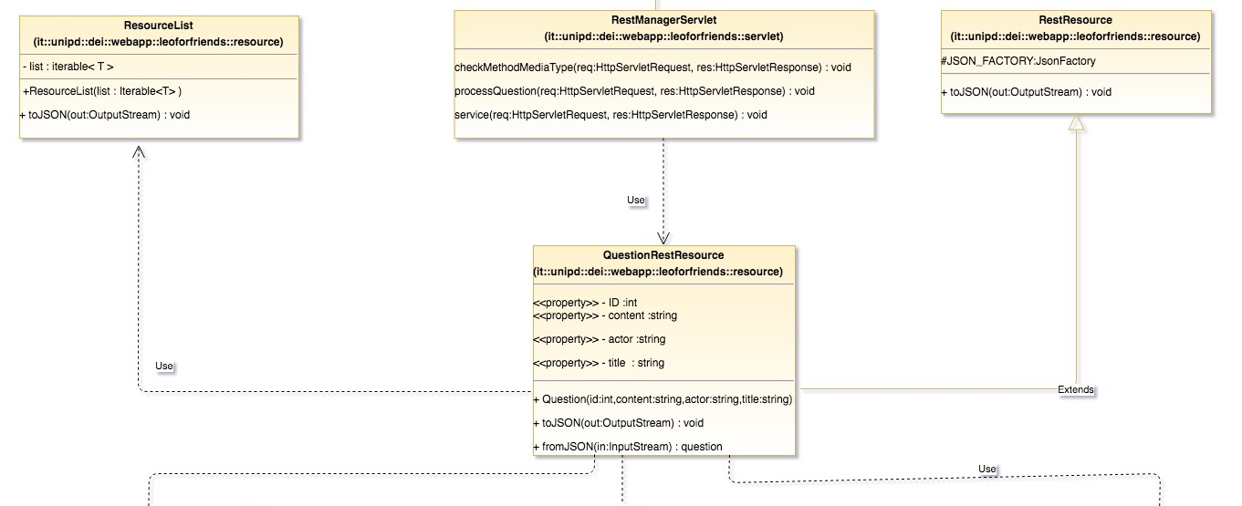
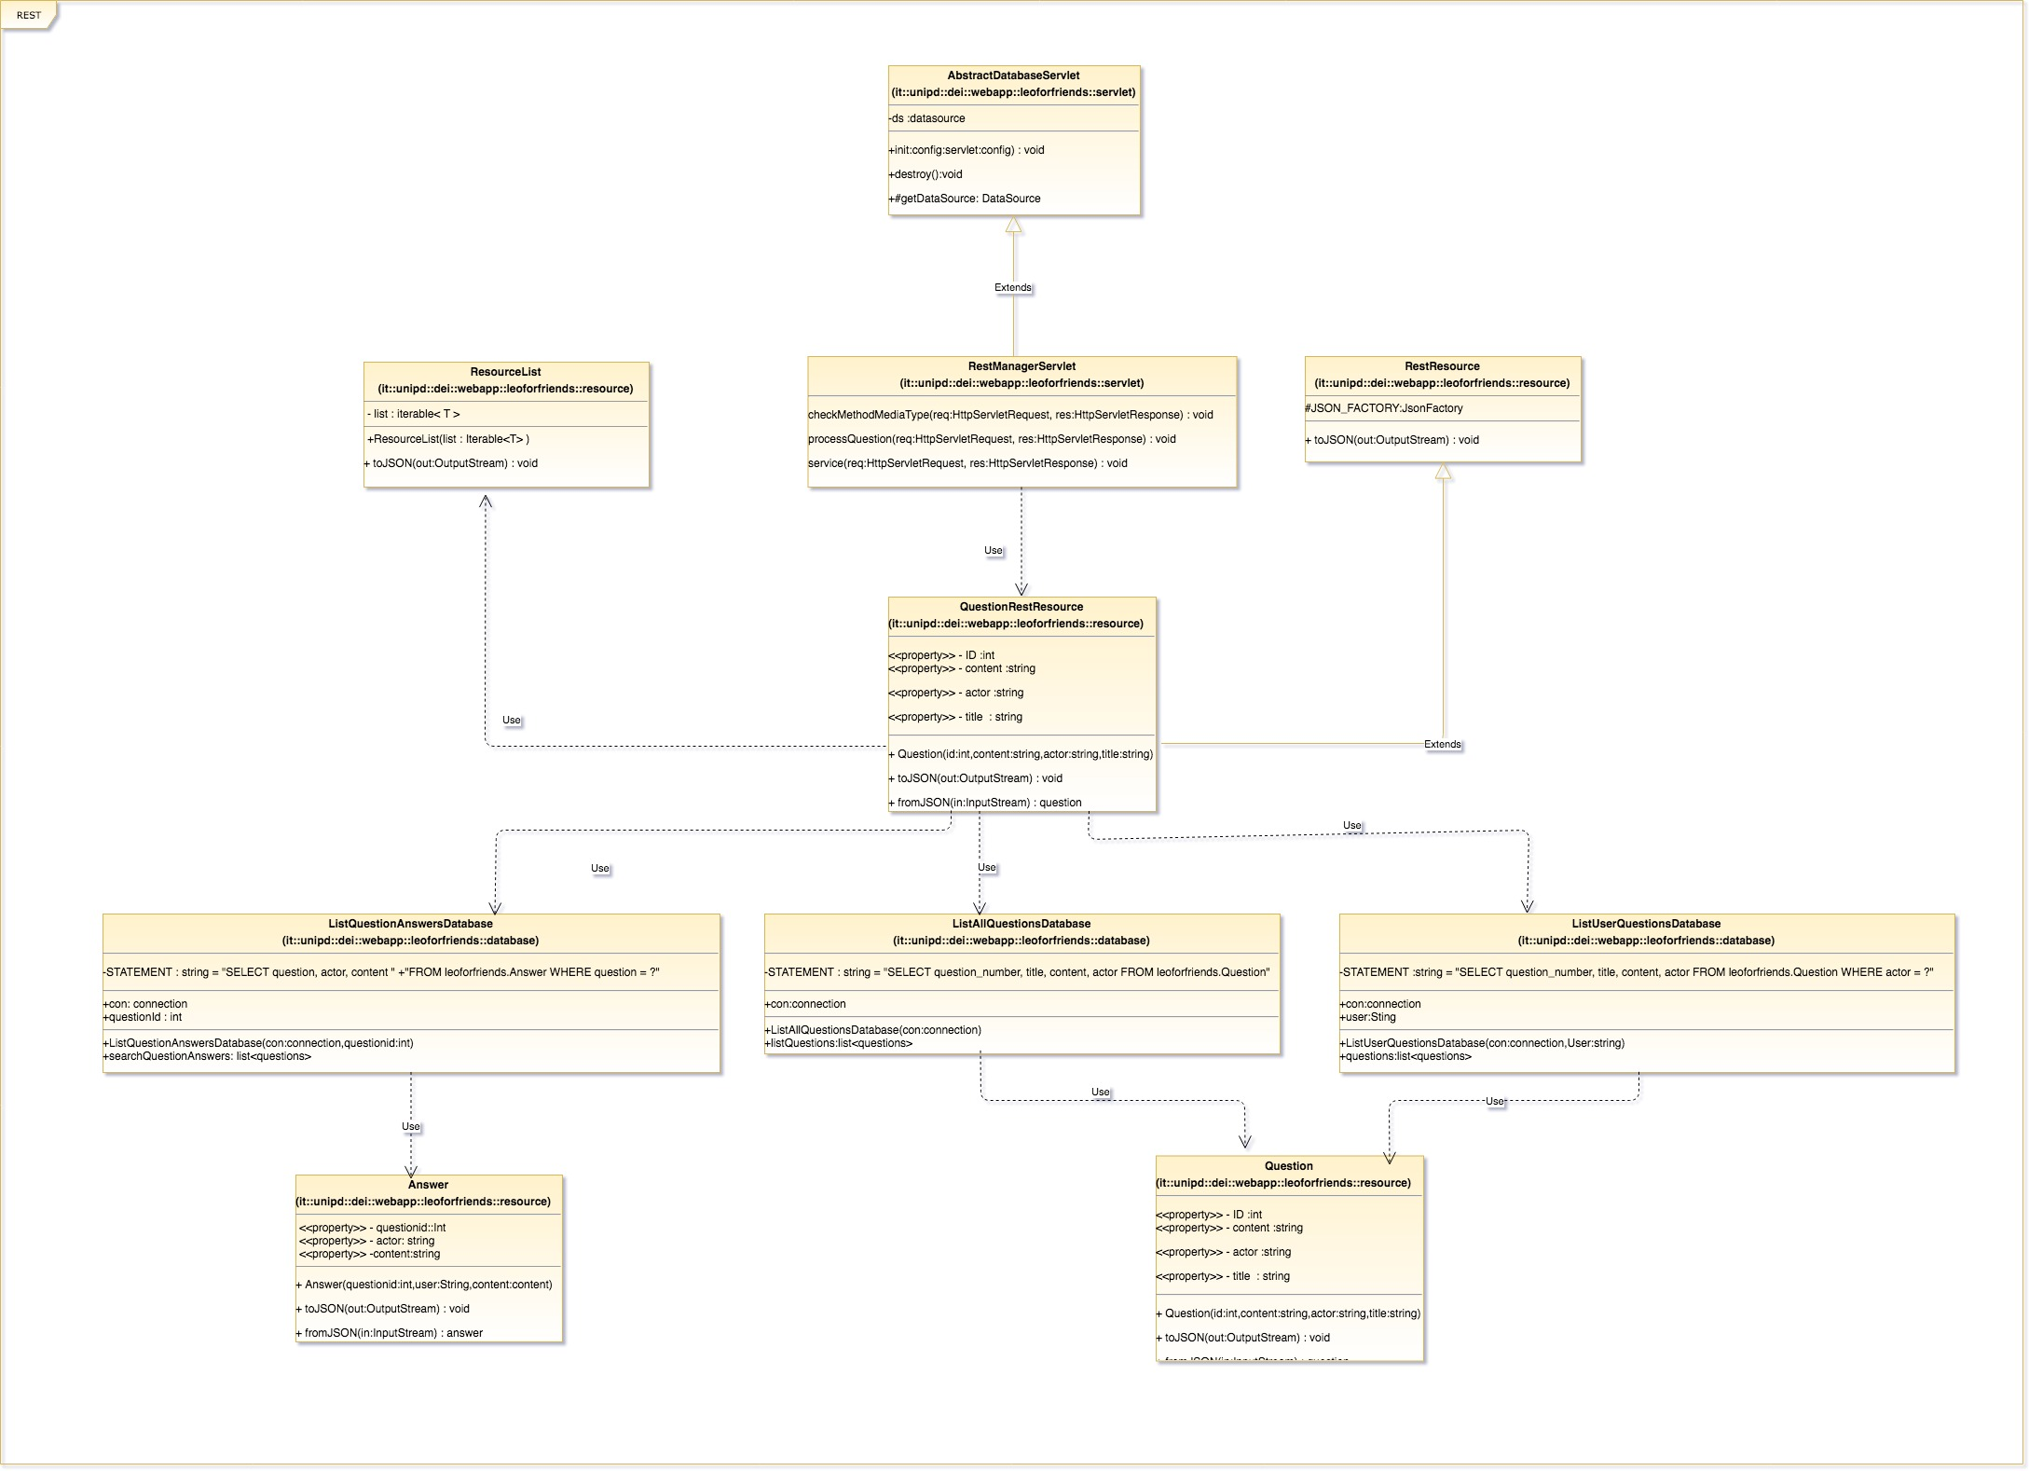
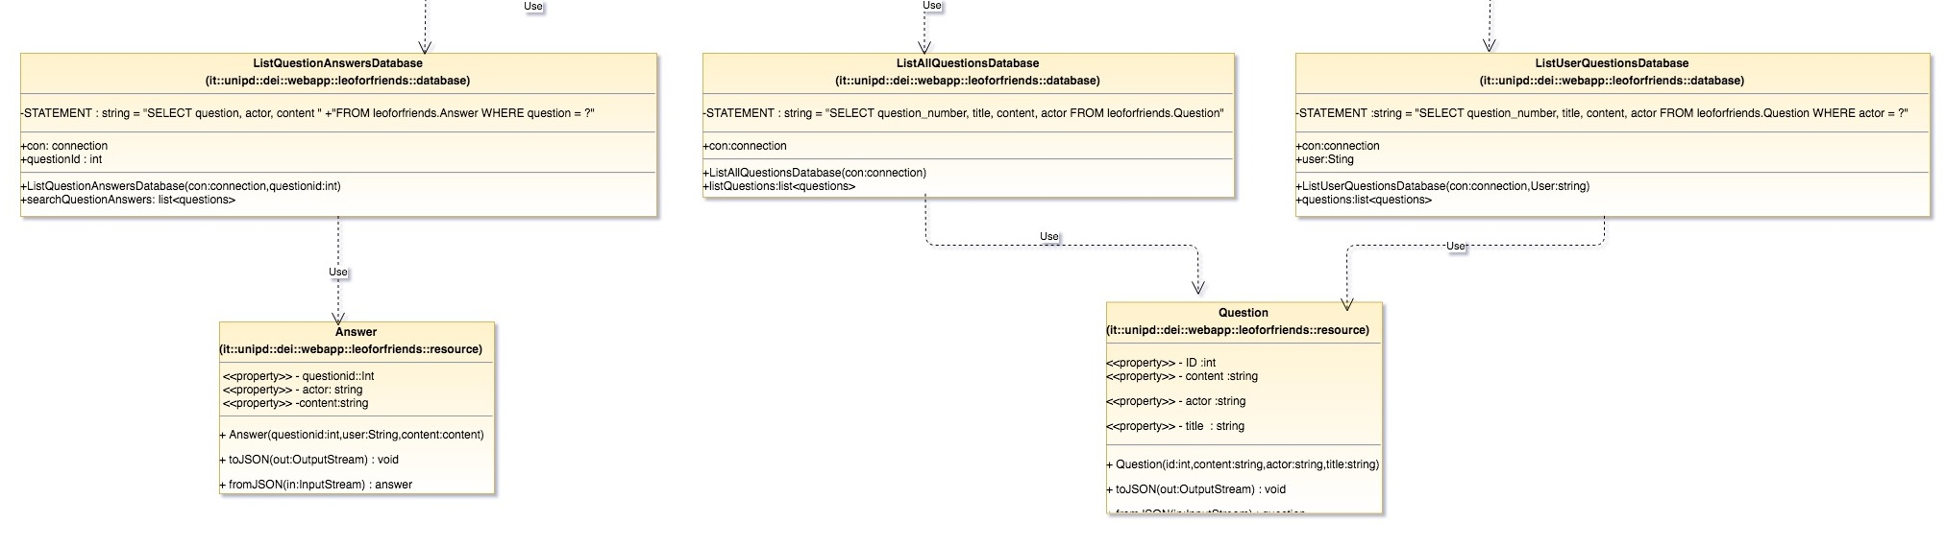
Rest Manager Servlet and its auxiliary classes are reported in the relative UML class diagram.
REST

Slide 17
Effusion of Data
3
between Client and Server…..

Slide 18
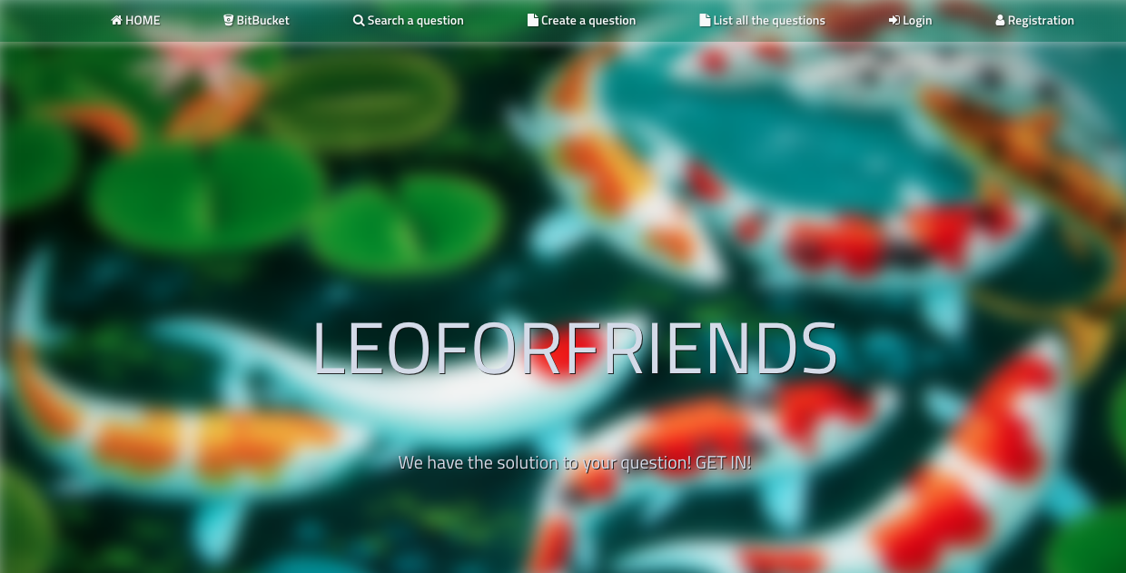
Desktop View
Desktop view of the client to access the services of the website.
Place your screenshot hre

Slide 19
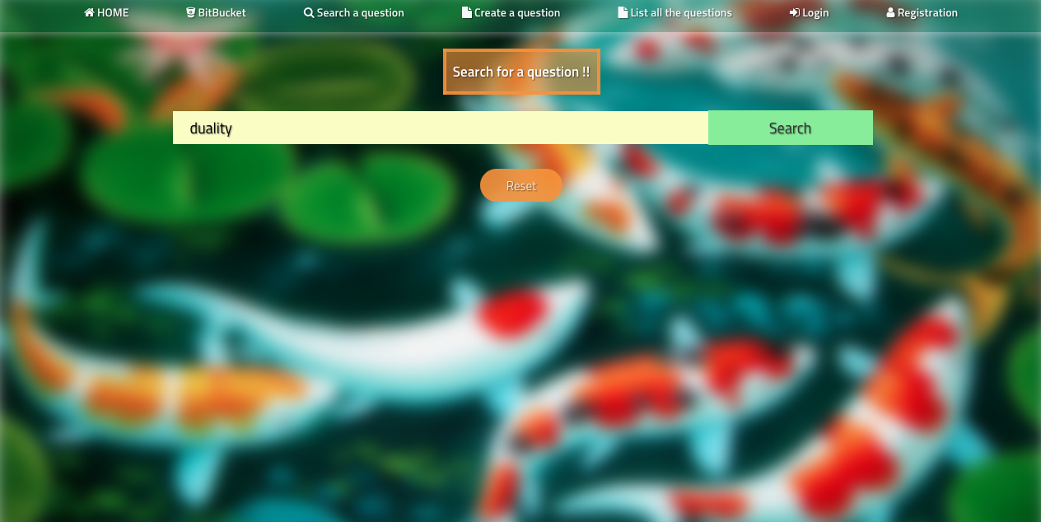
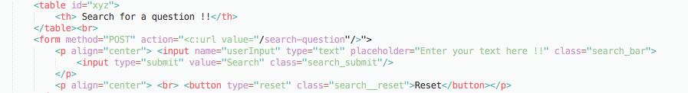
Flow of Data between client and server
01
Client INPUT
02
I/P to Servlet
03
Servlet executions
04
Output to Client

Slide 20
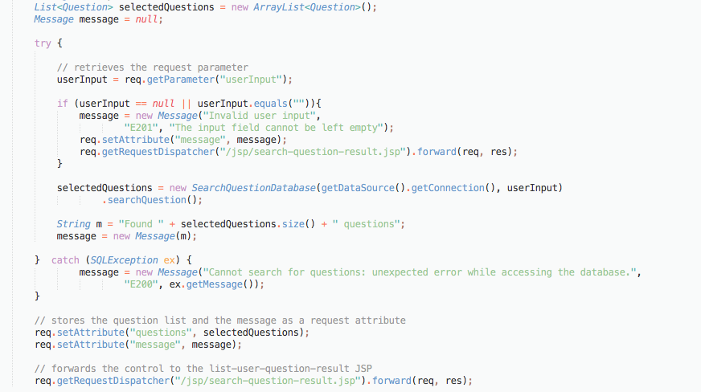
Flow of Data between client and server
01
Client INPUT
02
I/P to Servlet
03
Servlet executions
04
Output to Client

Slide 21
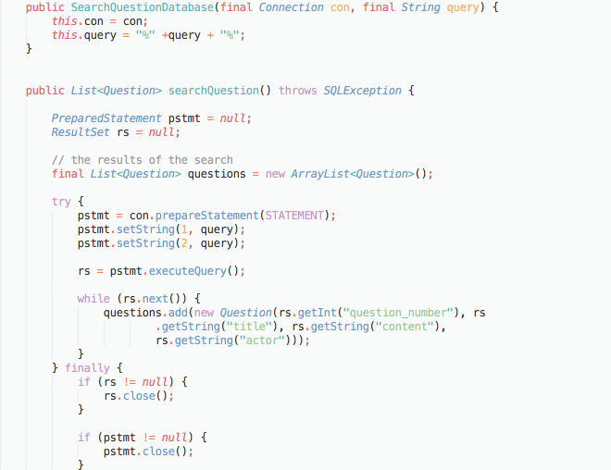
Flow of Data between client and server
01
Client INPUT
02
I/P to Servlet
03
Servlet executions
04
Output to Client

Slide 22
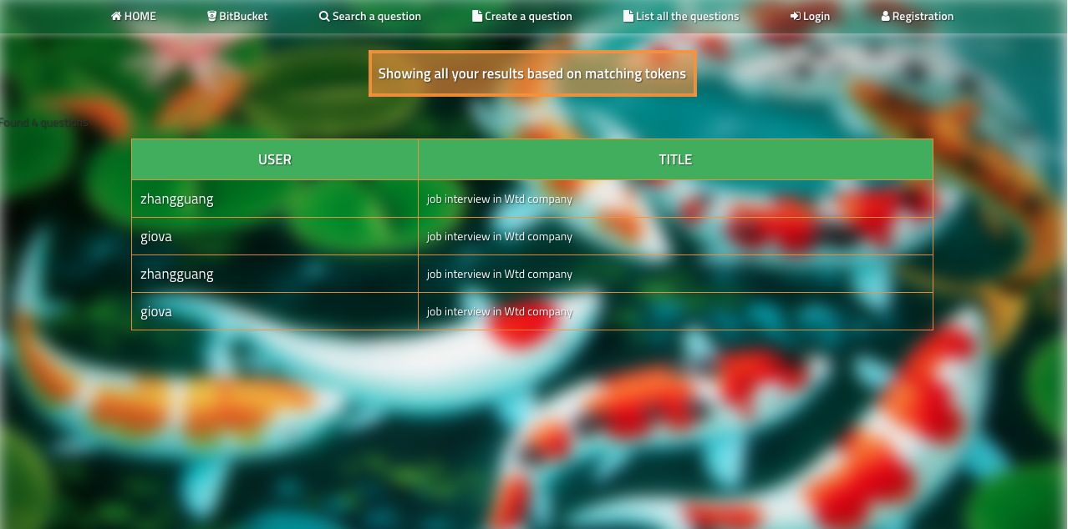
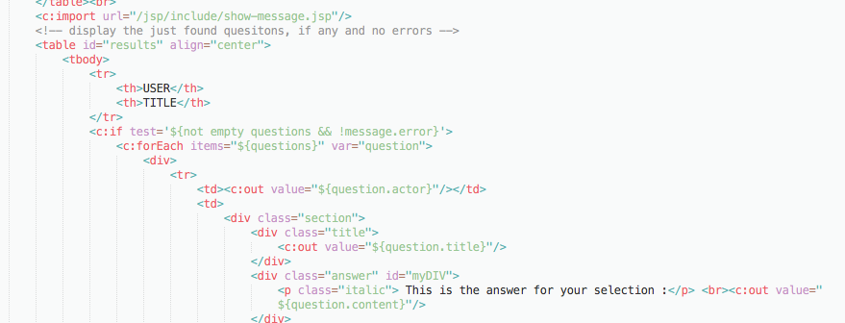
Flow of Data between client and server
01
Client INPUT
02
I/P to Servlet
03
Servlet executions
04
Output to Client

Slide 23
Client Side
4
Visualization and more ..

Slide 24
Visualize this thing that you want, see it, feel it, believe in it. Make your mental blue print, and begin to build.
-Robert Collier.

Slide 25
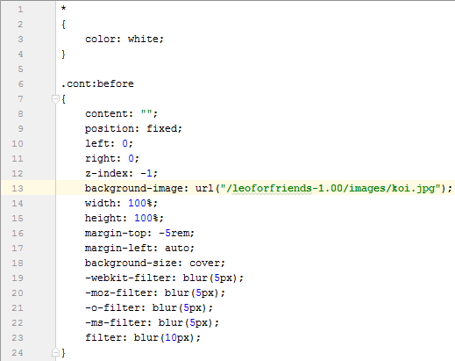
CSS
In each page is present a navigation bar that allows users to quickly go to the desired page
Using CSS we have applied a common style for all the page:
The same background;
Submission button color and shape;

Slide 26
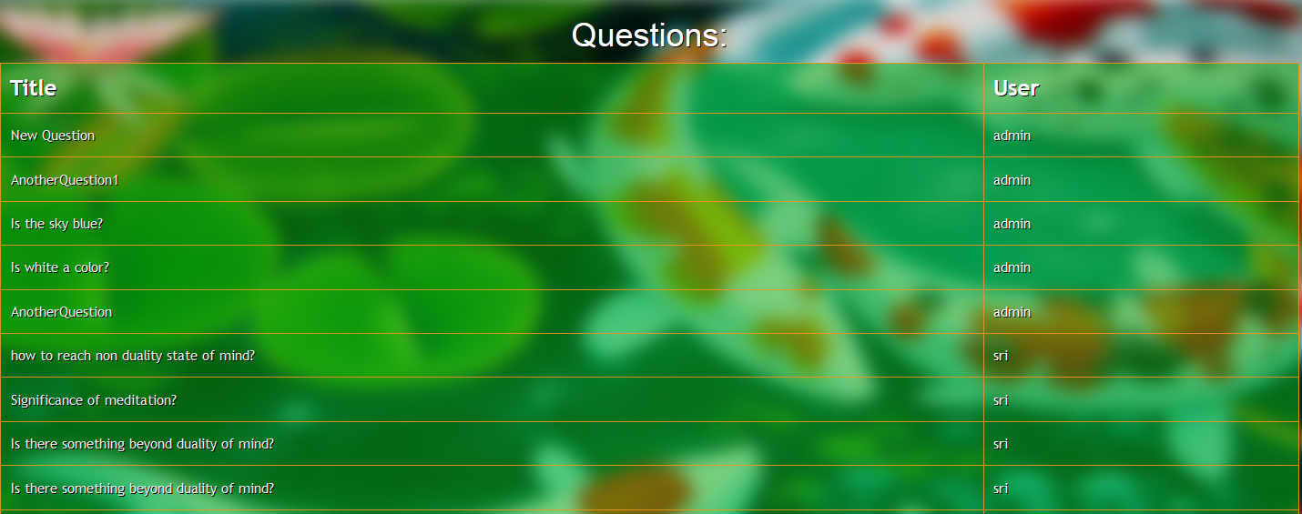
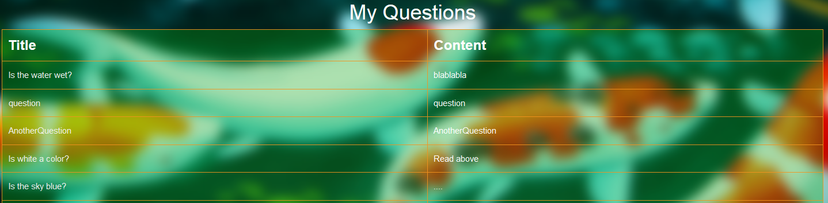
Java Script
Javascript has been used for different purposes:
To list all the question in the database, and of an user.

Slide 27
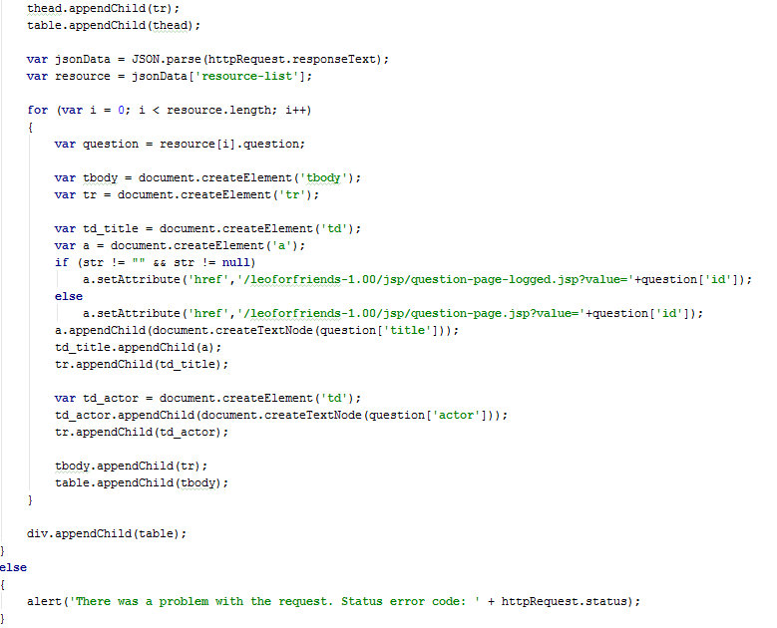
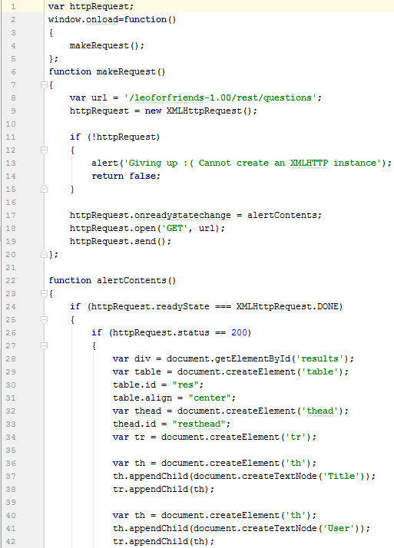
Java Script

Slide 28
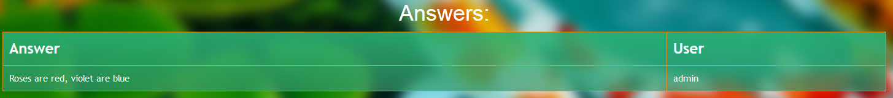

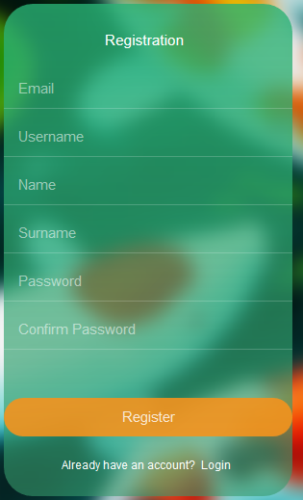
Java Script
To list all the answer of a question.
To show the input field for the answer text box.
To validate the registration form.

Slide 29
Cont.. To Demo
To better understand the web application we are going to show a brief demo.

Slide 30
THANK YOU!
Any questions?

